Slide 1

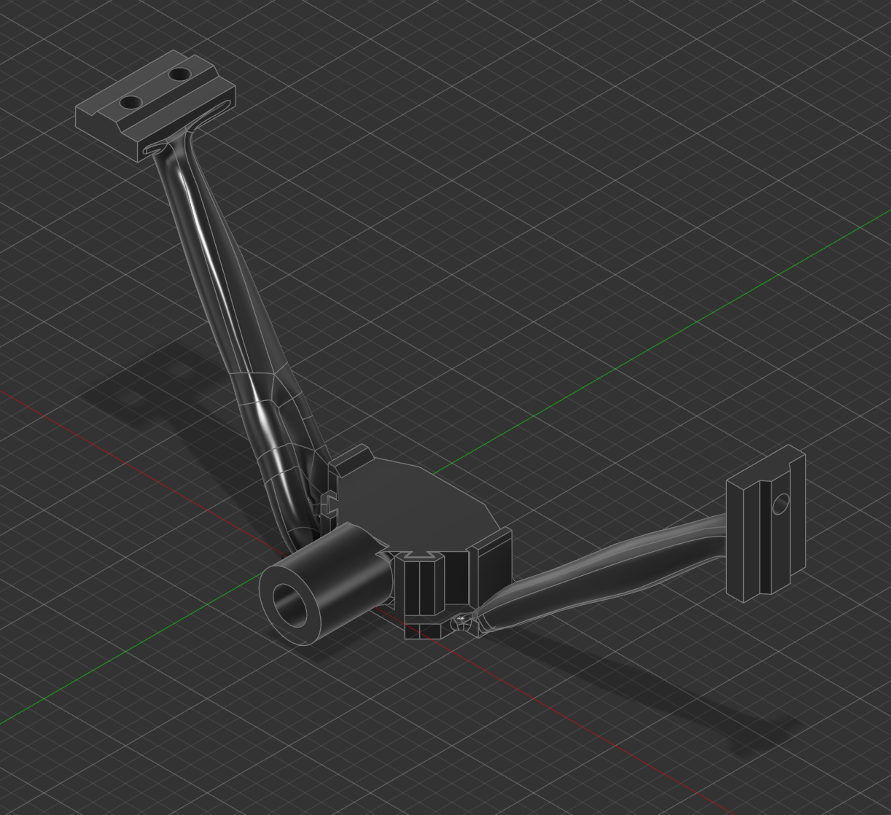
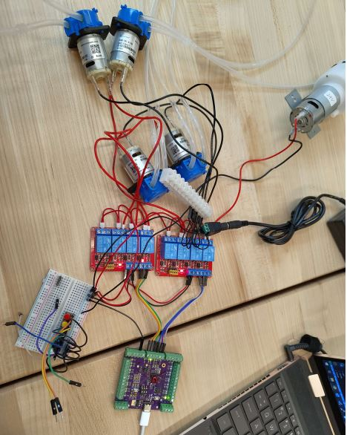
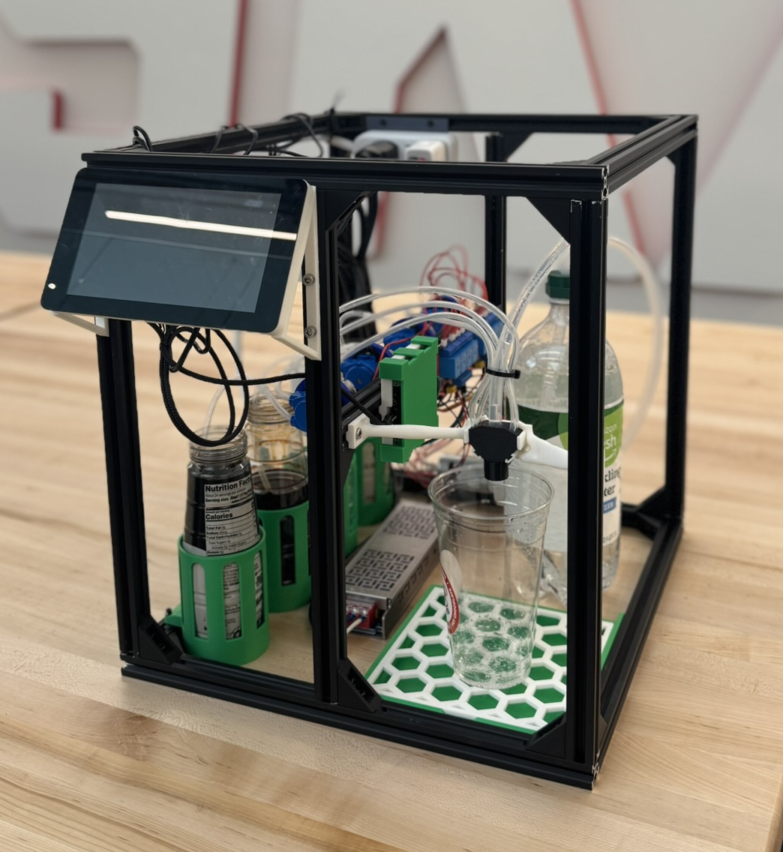
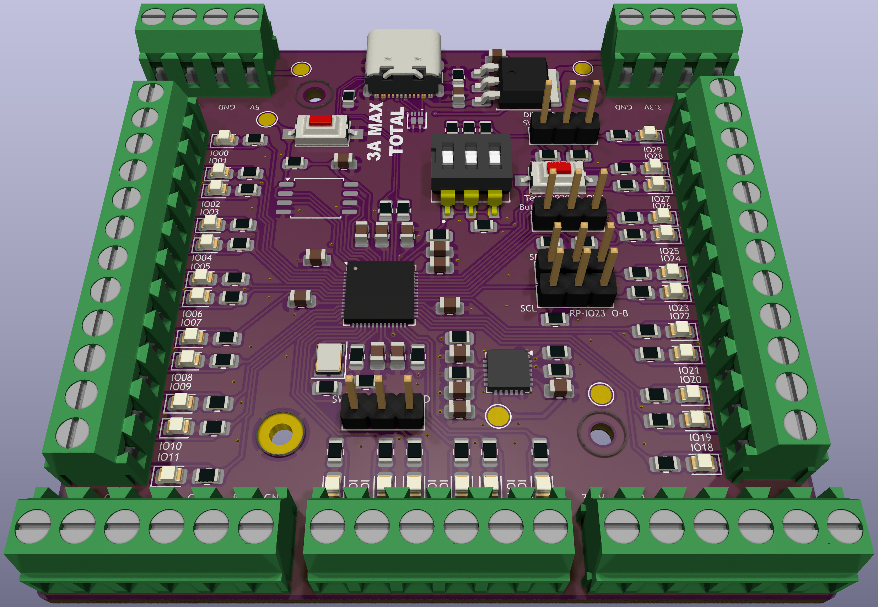
SodaShop
G185: Justin Kleen, Austin Koenigs, Paul Litherland, Liam O’Malley, Nic Witulski
Department of Electrical and Computer Engineering
Components
Here is a list of the components used: Raspberry Pi 4 7” Touch Screen 2 x 4 Channel Relay Boards Custom PCB(RP2040) 4 x Peristaltic Pump (5W) 24 V Air Pump 24V, 400W Power Supply Aluminum Channeling TONS of 3D Printing
Problem Statement
Cans of soda and other soda mixing machines do not allow for customer customization and control. SodaShop allows for the ultimate customizability of soft drink creation bolstered by seamless automation. SodaShop will integrate the customizability of modern soda machines found in restaurants with the ease of access of having soda from the comfort of your home. Additionally, SodaShop will utilize a touchscreen with a friendly user interface which features flavor customization of up to four flavors, while also adjusting the amount of syrup dispensed in order to provide further customizability. Finally, SodaShop aims to lessen the cost of buying CO2 canisters by utilizing club soda bottles.
Process
The project works as follows. When a user presses a drink option on the GUI of the touchscreen, the Raspberry Pi sends a UART signal to the custom RP2040 Board. The board sends a 3.3V signal to the dedicated relay board, which in turn, turns on both the air pump and peristaltic pump simultaneously, resulting in a dispensed beverage! The air pump solves the problem of losing the drinks carbonation because instead of using the turbulent motion of a pump, it smoothly pushes both carbonation and water without nearly as much turbulence. Finally, a user can load up to four flavor syrups, make custom strength drinks, as well as mix flavors like never before on a soda machine!
Design
The project implements: python programming, PCB design, 3D design and printing, soldering, and mechanical building. For the programming side, MicroPython code is uploaded to a RP2040 microprocessor which controls relay boards, and in turn, our pumps. The RP2040 on the custom PCB communicates with a Raspberry Pi 4 which is programmed in python. This Pi is used to run our GUI for our touchscreen. The frame is built out of 20mm aluminum channeling, with 3D printed brackets to hold it together. Additionally, much 3D design and printing was utilized to make custom mounts and brackets for every component mounted to the frame. Finally, the PCB was designed around a RP2040 microprocessor. The PCB has screw-mounted rails for GPIO, PWM, and other functions, as well as LEDs for testing and debugging. The PCB can be seen to the right.
Final Product

